Slide 1
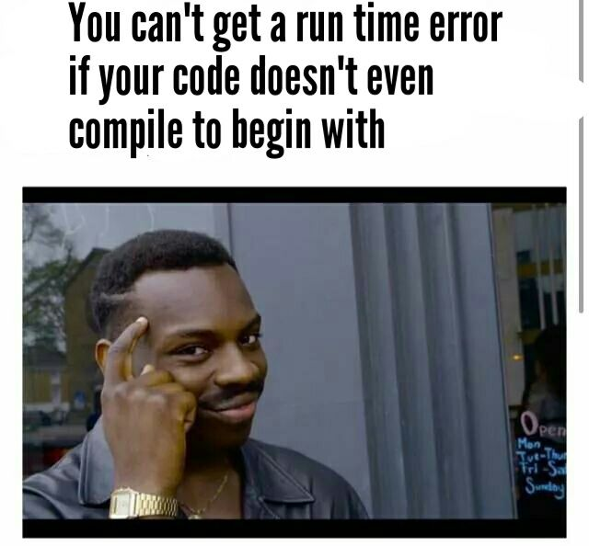
Week 10: Handling Exceptions
W. Clements
CSE 111: Programming with Functions

Slide 2
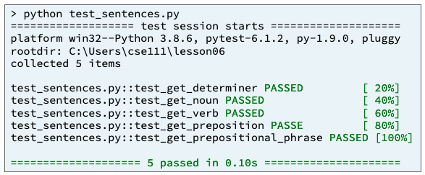
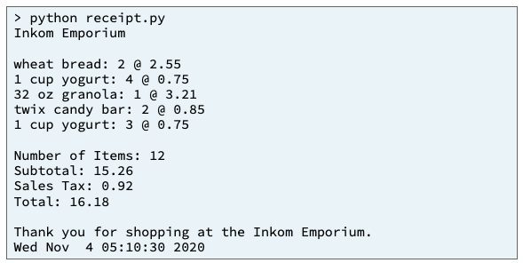
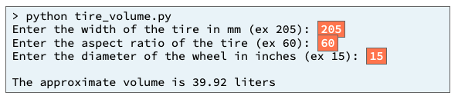
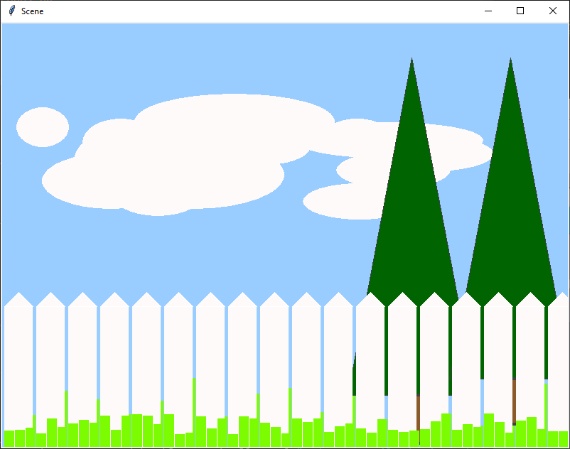
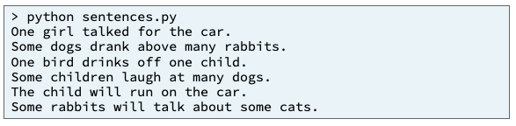
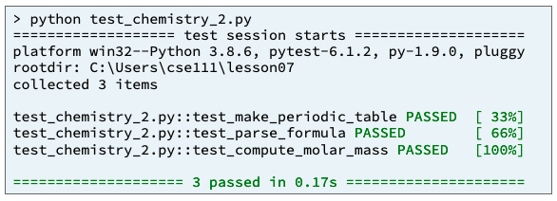
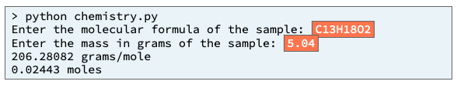
Preview of Projects
Sentence Program
Receipt Program
Inventory Program
Picture Program
Chemistry Program
Student Chosen Program
solves a real-world problem
useful in your major or hobby.
https://byui-cse.github.io/cse111-course/lesson11/prove.html

Slide 3
Overview
Prepare: Reading, Video
Checkpoint
Teach: Class Activity
Prove: Milestone
Ponder: Check your understanding

Slide 4
10 Prepare: Handling Exceptions
What Is an Exception?¶
How to Handle an Exception¶
Common Exception Types¶
TypeError¶
ValueError
ZeroDivisionError
IndexError¶
KeyError
FileNotFoundError
PermissionError¶
Example: Arithmetic¶
Example: Reading from a File¶
Validating User Input¶

Slide 5
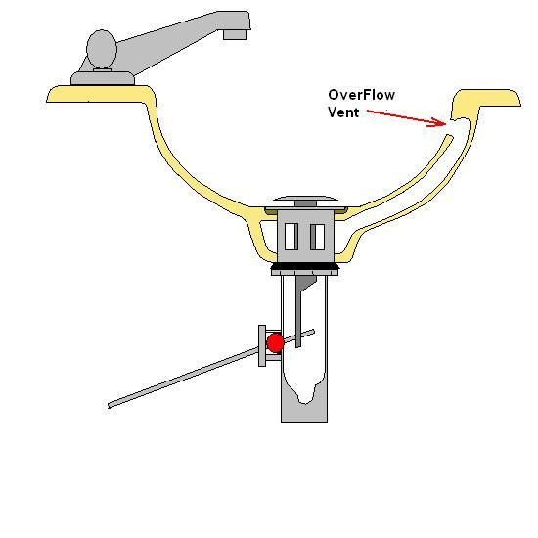
Why use exception handling
What types of errors have you gotten so far?
Compile errors
Runtime errors
Logic errors

Slide 6
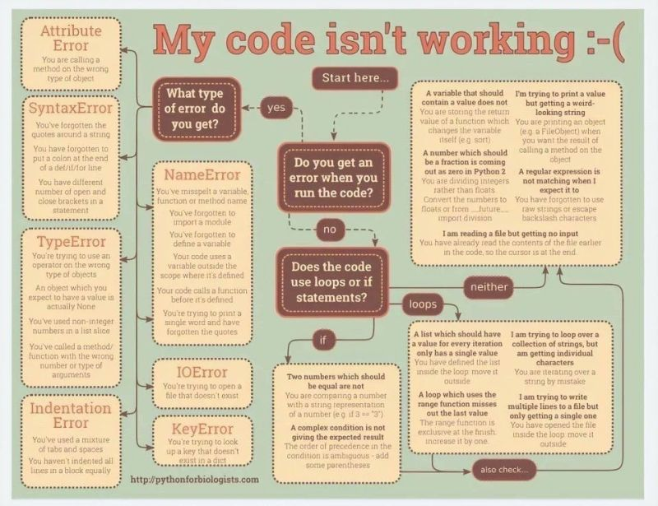

Slide 7

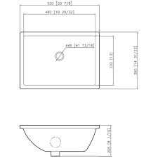

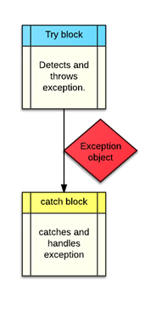
How do these sinks relate to try/throw/catch statements?

Slide 8
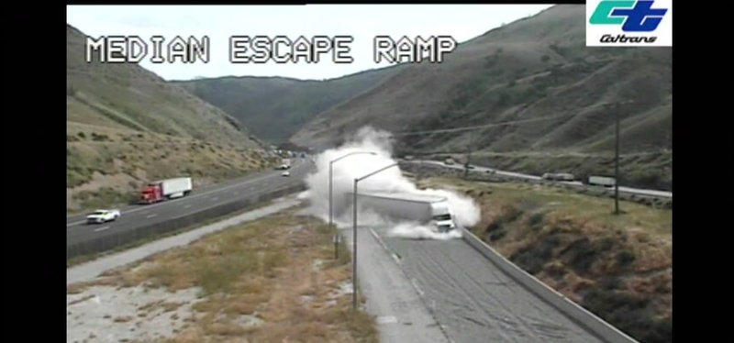
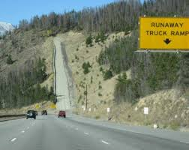
TryCatch

Slide 9
Error Handling
Types of Errors
Compile Error - syntax error
Runtime Errors - parsing error
Debugging - inside the program/code
Error Handling – outside the program that don’t have control over
Logic Errors
Works but the wrong response.

Slide 10
How do we return values from a function?
Return value
Pass-by-reference
Are these useful for returning errors?
I want to divide two numbers. What if the denominator is 0, divided by zero? How do we let a programmer (user) of our function know that the division failed?
What if we are accessing a key from a dictionary and the doesn’t exist?
What if we are add or multiplying large numbers, such that the 8,16,32 bits can’t hold the new number?
You ask a user for a number 1-10, and they enter “two”.
English example
Ambiguous questions
How about lawyer questions?
Do you mine that you mine? Yes or no
How would your friends describe you?
Are you unhappy in your current role?
What would you do if you didn’t get the role?

Slide 11
What is an exception and how do we handle it?
What is an exception?
How to handle exception
Any error that the function can’t handle.
We check for errors
Parameter checking
Calculation checking
Accessing checking
I/O checking
Key word: raise NameError(“…”)
When a function raises an exception, it needs to be caught with a try/except code block
For example
def raisedfunction():
raise NameError(“Hello World”)
def myfunction():
try:
raisedfunction()
catch NameError as namederrorvar
print(namederrorvar)

Slide 12
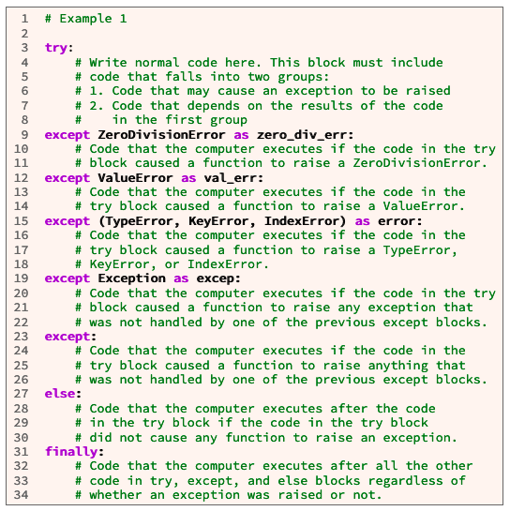
try:
# Write normal code here. This block must include
# code that falls into two groups:
# 1. Code that may cause an exception to be raised
# 2. Code that depends on the results from the code
# in the first group
except ZeroDivisionError as ex:
# Code that the computer executes if the code in the
# try block caused a ZeroDivisionError to be raised.
except ValueError as ex:
# Code that the computer executes if the code in
# the try block caused a ValueError to be raised.
except (TypeError, KeyError, NameError) as ex:
# Code that the computer executes if the code in the try
# block raised a TypeError, KeyError, or NameError.
except Exception as ex:
# Code that the computer executes if the code in the
# try block caused any exception to be raised that was
# not handled by one of the previous except blocks.
except:
# Code that the computer executes if the code in the
# try block caused anything to be raised that was
# not handled by one of the previous except blocks.
else:
# Code that the computer executes after the code
# in the try block if the code in the try block
# did not raise any exceptions.
finally:
# Code that is executed after all the other code in
# try, except, and else blocks regardless of whether # an exception was raised or not.

Slide 13
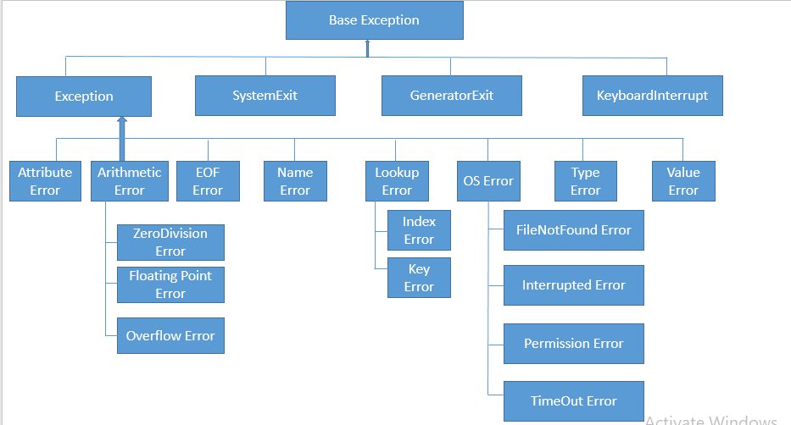
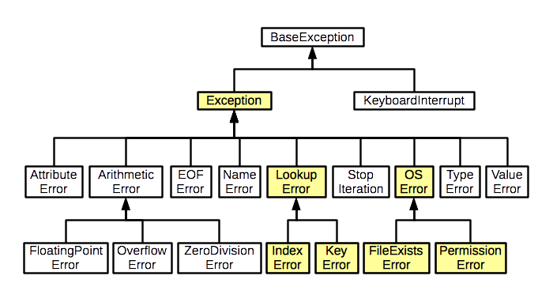
Error Type

Slide 14
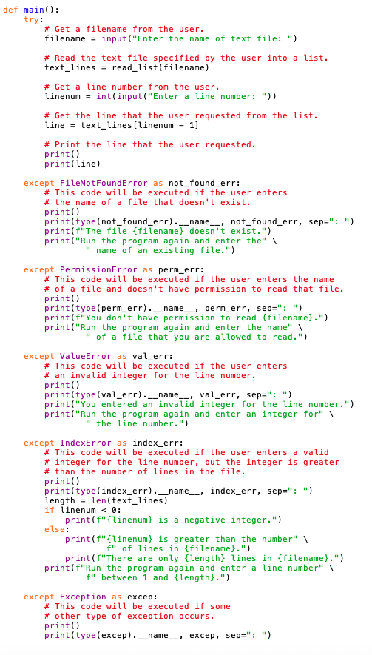
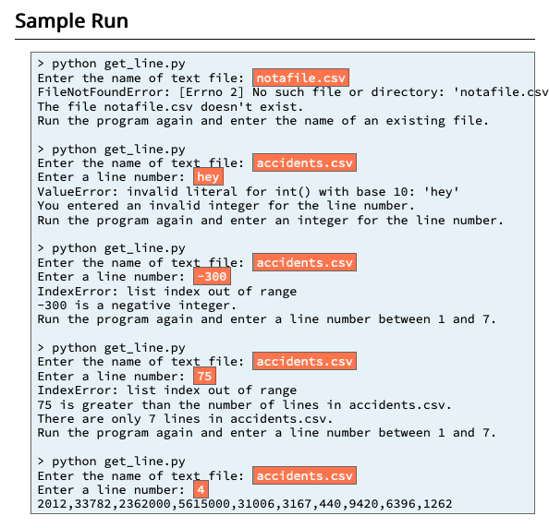
10 Checkpoint: Handling Exceptions
Purpose¶
Assignment
Improve your understanding of how to handle exceptions in a Python program.
Do the following:
Download and save the accidents.csv and get_line.py files in the same folder. get_line.py is a simple program that asks a user to input the name of a text file and a line number.
Then it prints the text that is in the file on the requested line.
Open get_line.py in VS Code and notice the try block at line 10 and the five except blocks at lines 27–74, each handling a different type of exception.
Run the get_line.py program five times and enter the input shown in the Sample Run section below. For each of the first four times that you run the program, find the lines of code in get_line.py that handled the exception that was raised.
https://byui-cse.github.io/cse111-course/lesson10/check.html

Slide 15
10 Team Activity: Handling Exceptions

Slide 16
10 Team Activity: Handling Exceptions
Problem Statement¶
Every year in the United States, thousands of people are killed and millions more are injured in traffic accidents on the nation's roads and highways.
The U.S. National Highway Traffic Safety Administration (NHTSA) maintains data about the accidents, including a list of factors contributing to each accident.
The CSV file accidents.csv contains summary data from the NHTSA about the accidents that occurred on U.S. roads and highways during the years 2010 through 2017.
accidents.py is a Python program that uses the data to estimate how many lives would have been saved and injuries avoided if drivers had stopped dangerous behavior such as speeding and using cell phones while driving.
Unfortunately, accidents.py does not contain any code to validate the input that the user enters while the program is running.
Add exception handling code to accidents.py to validate the user's input and print helpful error messages when the user enters incorrect input.

Slide 17
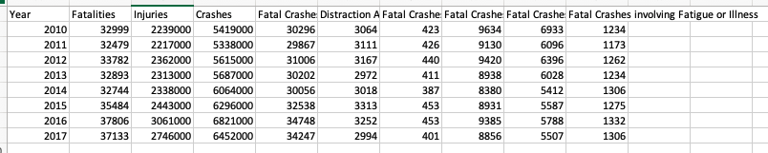
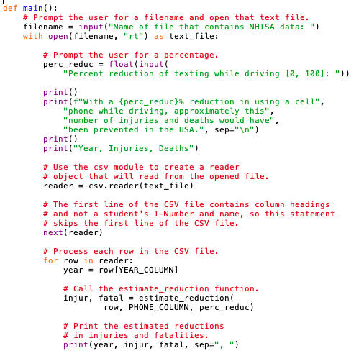
10 Team Activity: Handling Exceptions
Assignment
Line 21-22
Do the following:
Download and save both accidents.csv and accidents.py in the same folder.
Open accidents.csv in VS Code or another editor and notice that it contains ten columns and eight rows of data regarding traffic accidents in the United States.
Open accidents.py in VS Code and notice that lines 21–22 contain code to ask the user for a filename and then open that file.
It is possible that when the computer executes line 21, the user may enter the name of a file that does not exist or may enter the name of a file that the user does not have permission to read.
These two situations cause the computer to raise a FileNotFoundError or PermissionError when the computer tries to open the file at line 22.
Notice that lines 25–26 of accidents.py contains code to prompt the user for a number. It is possible that while the computer is executing lines 25–26, the user may enter text that is not a number, for example: "4r0". This situation causes the computer to raise a ValueError.
It is also possible that the user may enter a number that is too low or too high, for example: -15 or 701234932. In this situation, the computer does not raise an exception, but this situation is still a mistake that the program should alert the user about.
Notice that lines 45–55 of accidents.py contain code to process each line of the CSV file.
It is possible that the CSV file is formatted incorrectly which would cause the computer to raise csv.Error. It is also possible that one of the rows in the CSV file contains zero (0) in the "Fatal Crashes" column. This would cause the computer to raise ZeroDivisionError at line 75 within the estimate_reduction function.
Line 25-26
Line 25-26

Slide 18
10 Team Activity: Handling Exceptions
Core Requirements¶
Stretch Challenges¶
Add exception handling code that prints a useful error message when the computer raises
FileNotFoundError or
PermissionError.
Add exception handling code that prints a useful error message when the computer raises
ValueError while it is converting the percentage entered by the user to a float.
Add code that prints a useful error message when the user enters a percentage that is less than 0 or greater than 100.
Hint: you could add an if statement immediately after the line of code that gets the percentage from the user.
If your team finishes the core requirements in less than an hour, complete one or more of these stretch challenges. Note that the stretch challenges are optional.
Add exception handling code to handle ZeroDivisionError that might be raised by the estimate_reduction function.
This exception handling code should print a useful error message that includes the filename and line number of the line that contains zero (0) in the "Fatal Crashes" column.
Add exception handling code to handle csv.
Error that might be raised by the csv module.
This exception handling code should print a useful error message that includes the filename and line number of the line that is formatted incorrectly.
Test all of your error handling code, including the code that handles
ZeroDivisionError and
To test ZeroDivisionError, you could temporarily change one of the numbers in the "Fatal Crashes" column of accidents.csv to zero (0).
PermissionError.
To test PermissionError, you could create a CSV file or a simple text file and then use File Explorer or Finder to change the permissions on that file so that your account doesn't have permission to read that file.
! FileExistError
! PermissionError
! ValueError
! TypeError

Slide 19
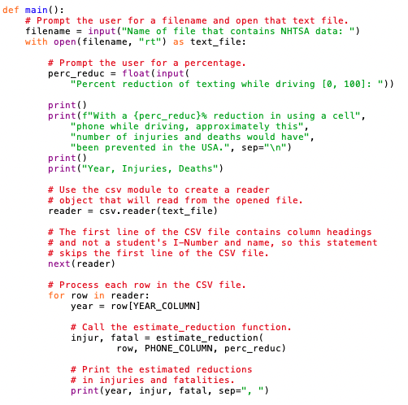
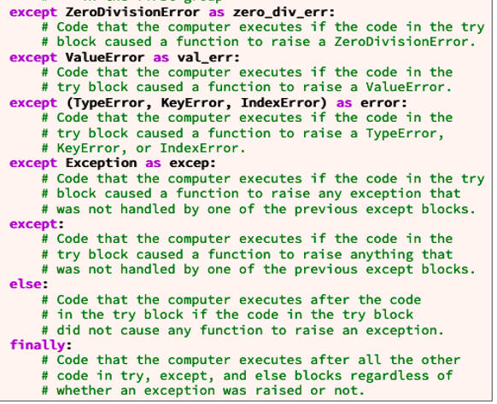
Try
catch

Slide 20
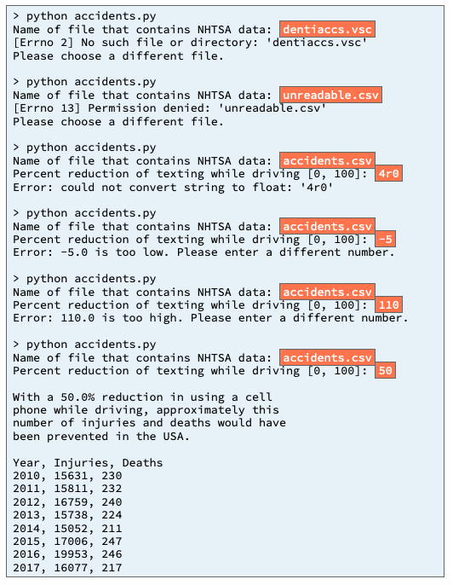
Products.csv
YEAR_COLUMN
! FileExistError
FATALITIES_COLUMN
INJURIES_COLUMN
CRASHES_COLUMN
! PermissionError
FATAL_CRASHES_COLUMN
DISTRACT_COLUMN
PHONE_COLUMN
SPEED_COLUMN
! TypeError
DUI_COLUMN
Process
Output
Input
FATIGUE_COLUMN
accidents.py
main
! ValueError
open
accidents.csv
Try
catch
! ValueError
Csv.reader()
Reader (csv list of lists)
! FileNotFoundError
! PermissionError
! PermissionError
estimate_reduction
! ZeroDivisionError
! ValueError

Slide 21
10 Team Activity: Handling Exceptions
! FileExistError
! PermissionError
Testing Procedure¶
! TypeError
Verify that your program works correctly by following each step in this testing procedure:
Run the accidents.py program and enter the inputs shown below.
Verify that the exception handling code that you added to accidents.py prints error messages as shown below.
! ValueError
! ValueError

Slide 22
10 Prove Assignment: Handling Exceptions

Slide 23
10 Prove Assignment: Handling Exceptions
Purpose
Problem Statement¶
Prove that you can write a Python program that handles exceptions, including FileNotFoundError, PermissionError, and KeyError.
A local grocery store subscribes to an online service that enables its customers to order groceries online.
After a customer completes an order, the online service sends a CSV file that contains the customer's requests to the grocery store.
The store needs you to write a program that reads the CSV file and prints to the terminal window a receipt that lists the purchased items and shows the subtotal, the sales tax amount, and the total.

Slide 24
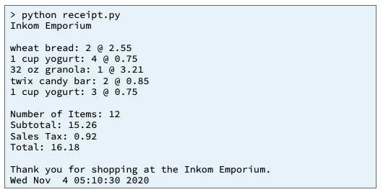
10 Prove Assignment: Handling Exceptions
Assignment¶
During the prove milestone for the previous lesson, you wrote the part of this program that reads and processes two CSV files, one named products.csv that contains a catalog of products and one named request.csv that contains a customer's order. During this prove assignment, you will add code to finish printing a receipt and to handle any exceptions that might occur while your program is running.
Specifically, your program must do the following:
Print the store name at the top of the receipt.
Print the list of ordered items.
Sum and print the number of ordered items.
Sum and print the subtotal due.
Compute and print the sales tax amount. Use 6% as the sales tax rate.
Compute and print the total amount due.
Print a thank you message.
Get the current date and time from your computer's operating system and print the current date and time.
Include a try block and except blocks to handle FileNotFoundError, PermissionError, and KeyError.

Slide 25
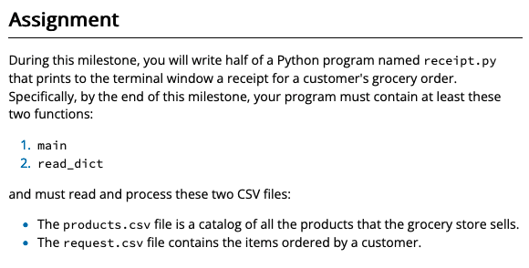
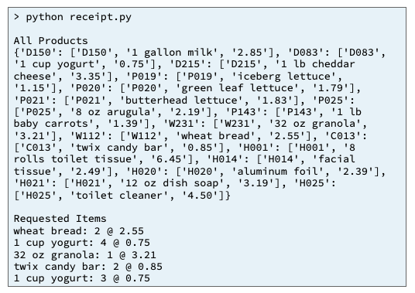
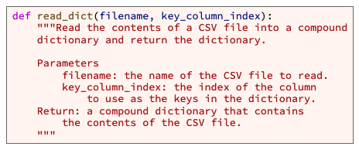
Products.csv
Request.csv
(PK)Product#
Product#
Name
Quantity
Price
dictionary
list
Input
Process
Output
get_products()
receipt.py
main
Print_all_products()
products.csv
Products_dict
Requested_items_list
Print_receipt()
get_requests()
requests
requests.csv
Requests, products
filename, key_column_index
determine_receipt
read_dictionary

Slide 26
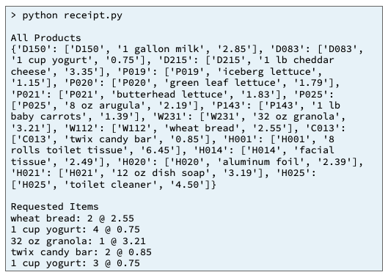
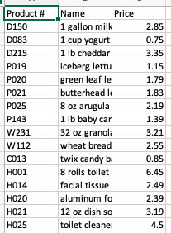
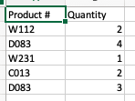
Input
Process
Output
Products_dict
determine_receipt
Requested_items = []
itemStr= f”Requested Items”
Requested_items = [
“Requested Items”,
“Wheat bread: 2 @ 2.55”,
“1 cup yogurt: 4 @ .75”,
“32 oz granola: 1 @ 3.21”, …
Requested_item.append(itemStr)
Products.csv
For request in requests
(PK)Product#
Name: quantity: Price
Name
Request is a list
Price
Product = products_dict[request[0] ]
ProductName = Product[ NAME]
ProductQuantity = request[ QUANITY]
ProductPrice = Product[ PRICE ]
itemStr = F’{Product Name} : {Product Quantity} @ {ProductPrice}’
Requested_items.append(itemStr)
dictionary
Key = P#
Value = [Name(0), Price(1)]
requests
Product is a list
Request.csv
Product#
Quantity
list
[Product#(0), Quantiy)
return Requested_items

Slide 27
Input
Process
Output
determine_receipt
Specifically, your program must do the following:
Print the store name at the top of the receipt.
Print the list of ordered items.
Sum and print the number of ordered items.
Sum and print the subtotal due.
Compute and print the sales tax amount. Use 6% as the sales tax rate.
Compute and print the total amount due.
Print a thank you message.
Get the current date and time from your computer's operating system and print the current date and time.
Include a try block and except blocks to handle FileNotFoundError, PermissionError, and KeyError.
Products.csv
Request.csv
Number_of_items (req 3)
(PK)Product#
Product#
Name
Quantity
Subtotal (req 4)
Price
SalesTax (req 5)
dictionary
list
Total (req 6)

Slide 28
Input
Process
Output
determine_receipt
List?
Products.csv
Request.csv
Number_of_items (req 3)
(PK)Product#
Product#
dictionary?
Name
Quantity
Subtotal (req 4)
Price
Return_list = [
itemnum,
subtotal,
salestax,
total]
Return_dictionary = {
”itemnumber”: ##,
“subtotal” : ##.##,
“salestax” : ##.##,
“total” : ##.## }
SalesTax (req 5)
dictionary
list
Total (req 6)
Requests, products
?
calcNumberOfItems
salestax
Requests, products
?
subtotal
total

Slide 29
Products.csv
Request.csv
(PK)Product#
Product#
Name
Quantity
Price
dictionary
list
Input
Process
Output
get_products()
receipt.py
main
products.csv
Try
catch
Products_dict
Printables
?
Print_receipt()
requests
get_requests()
requests.csv
Print_errormsg()
! FileNotFoundError
! KeyError
Requests, products
! PermissionError
Itemize_list
filename, key_column_index
Requests, products
read_dictionary
determine_receipt
datetime
Now()
weekday()
Date_time_value
Day_ofweek

Slide 30
10 Prove Assignment: Handling Exceptions
Exceeding the Requirements¶
If your program fulfills the requirements for this assignment as described in the previous prove milestone and the Assignment section above, your program will earn 93% of the possible points. In order to earn the remaining 7% of points, you will need to add one or more features to your program so that it exceeds the requirements. Here are a few suggestions for additional features that you could add to your program if you wish.
Write code to discount the product prices by 10% if today is Tuesday or Wednesday.
Write code to discount the product prices by 10% if the current time of day is before 11:00 a.m.
Write code to print a coupon at the bottom of the receipt. Write the code so that it will always print a coupon for one of the products ordered by the customer.
Write code to print at the bottom of the receipt an invitation for the customer to complete an online survey.

